Slide 1
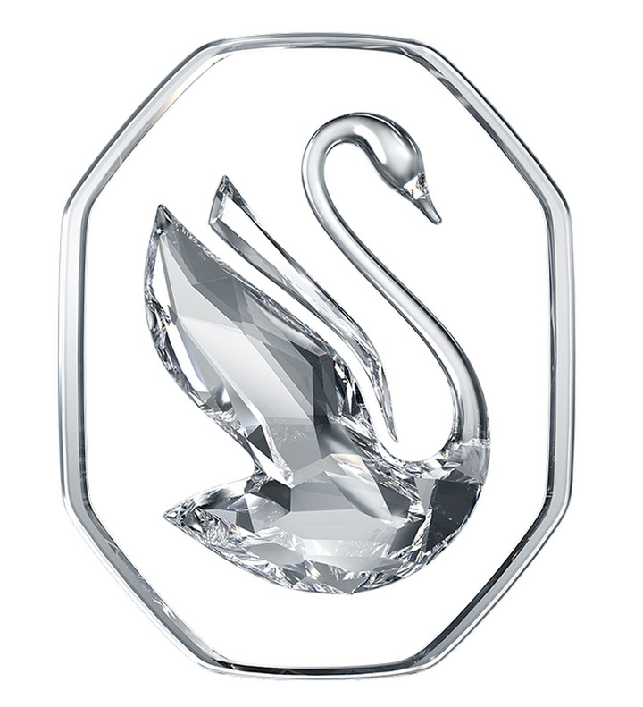
SWAROSVKY MARKET ANALYSIS
NaoNexus – NaoChallenge 2024

Slide 2
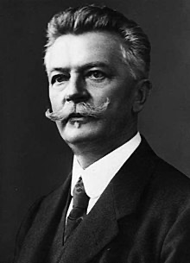
BRAND INTRODUCTION
The Swarovski family business, now in its fifth generation, was founded in 1895 in Wattens, a small Austrian municipality.
Its production began with the patenting of a new machine, registered by its founder, Daniel Swarovski.
The composition of Swarovski crystal is also secret, although it is now known that it is derived from a special combination of crystal and lead.

Slide 3

BRAND HISTORY
Daniel Swarovski's idea was to create a 'diamond accessible to all' and so it happened.
Swarovski began its journey by producing crystal figurines of horses and swans, slowly over time, it expanded to jewellery, rings, necklaces, bracelets and charms.
All with that unique lustre and brilliance.
Over time, the company was divided into three industrial areas: Swarovski Crystal Business, which mainly produces crystal, jewellery and accessories; Swarovski Optik, which produces optical instruments such as telescopes, telescopic sights for rifles and binoculars; and Tyrolit, a manufacturer of grinding, sawing, drilling and dressing tools, as well as a supplier of tools and machines.

Slide 4
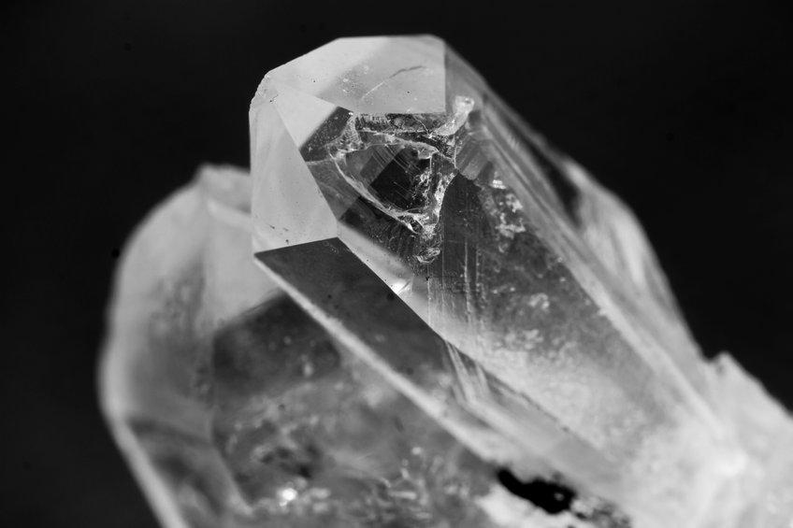
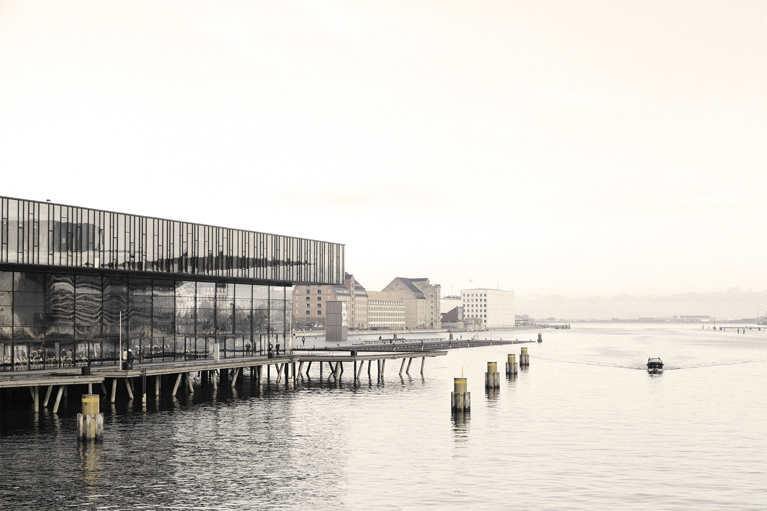
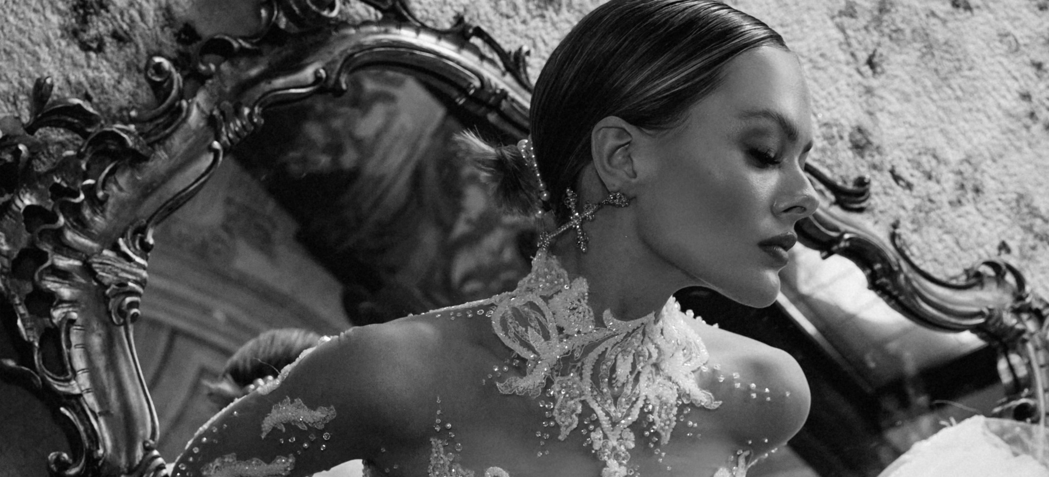

MARKET NICHE
MARKET
CUSTOMERS
Swarovski's main market niche is high-quality crystal jewellery and accessories.
Swarovski has a mainly female customer base, which includes women of all ages, from young to mature.
Since Swarovski products are considered luxury, the customer base tends to have a higher disposable income.

Slide 5
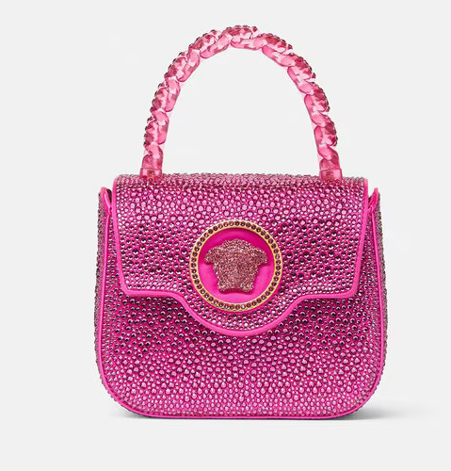
COLLABORATIONS
The market in which Swarovski operates has expanded through collaborations with luxury fashion houses such as Chanel, Versace and Dior, but also with many designers such as Christopher Kane and Jason Wu.
Important collaborations, which helped to bring the precious crystal figurines into all homes, were those with Disney and Warner Bros.

Slide 6
CRYSTAL QUALITY
01
ELEGANT DESIGN
02
PRODUCT ADVANTAGES
VARIETY OF PRODUCTS
03
TECHNOLOGICAL INNOVATION
04
PACKAGING AND PRESENTATION
05
the crystals are renowned for clarity, brilliance and precision
Swarovski jewellery, accessories and decorations are known for their elegance and sophistication, often featuring intricate details and distinctive styles
Swarovski produces products such as glass sculptures, miniatures, jewellery, rhinestones, home decorations and chandeliers
Swarovski continuously invests in technological innovation to constantly improve its products
items are packaged in elegant boxes or wrappings, making the shopping experience even more special

Slide 7
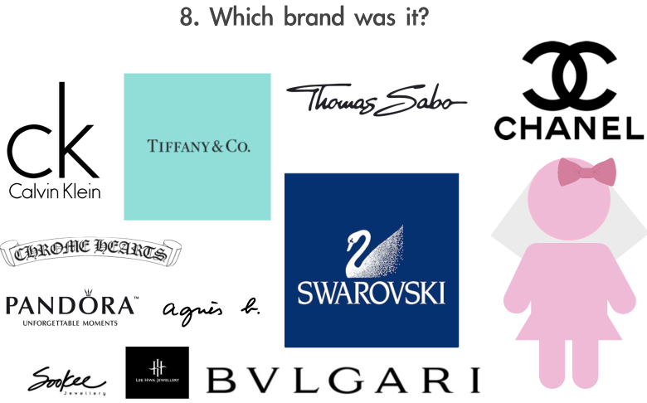
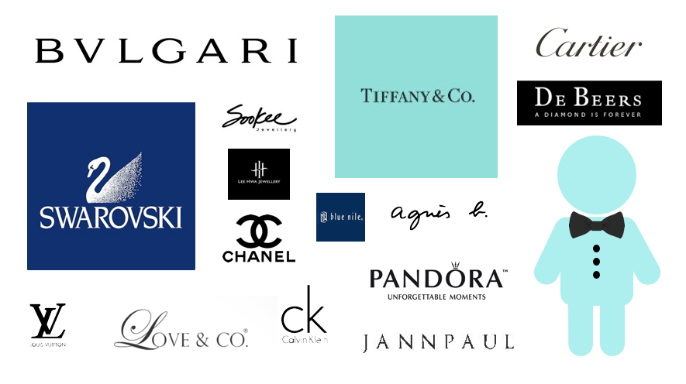
COMPETITORS
Swarovski's top 5 competitors in November 2023 are tiffany.com, cartier.com, bulgari.com, kendrascott.com and others.
According to Similarweb's monthly visit data, swarovski.com's top competitor in November 2023 is tiffany.com, with 5.2M visits. swarovski.com: The 2nd most similar website is cartier.com, with 4.5M visits in November 2023. In 3rd place is bulgari.com, with 1.9M visits.
kendrascott.com ranks 4th as the most similar website to swarovski.com, while bluenile.com holds 5th place. kendrascott.com and bluenile.com received 4.9M and 3.6M visits respectively in November 2023. The other five best-performing competitors are zales.com (7.2M visits in November 2023), jared.com (4.2M visits in November 2023), kay.com (9.4M visits in November 2023), brilliantearth.com (8.9M visits in November 2023) and christ.de (3.1M visits in November 2023).

Slide 8
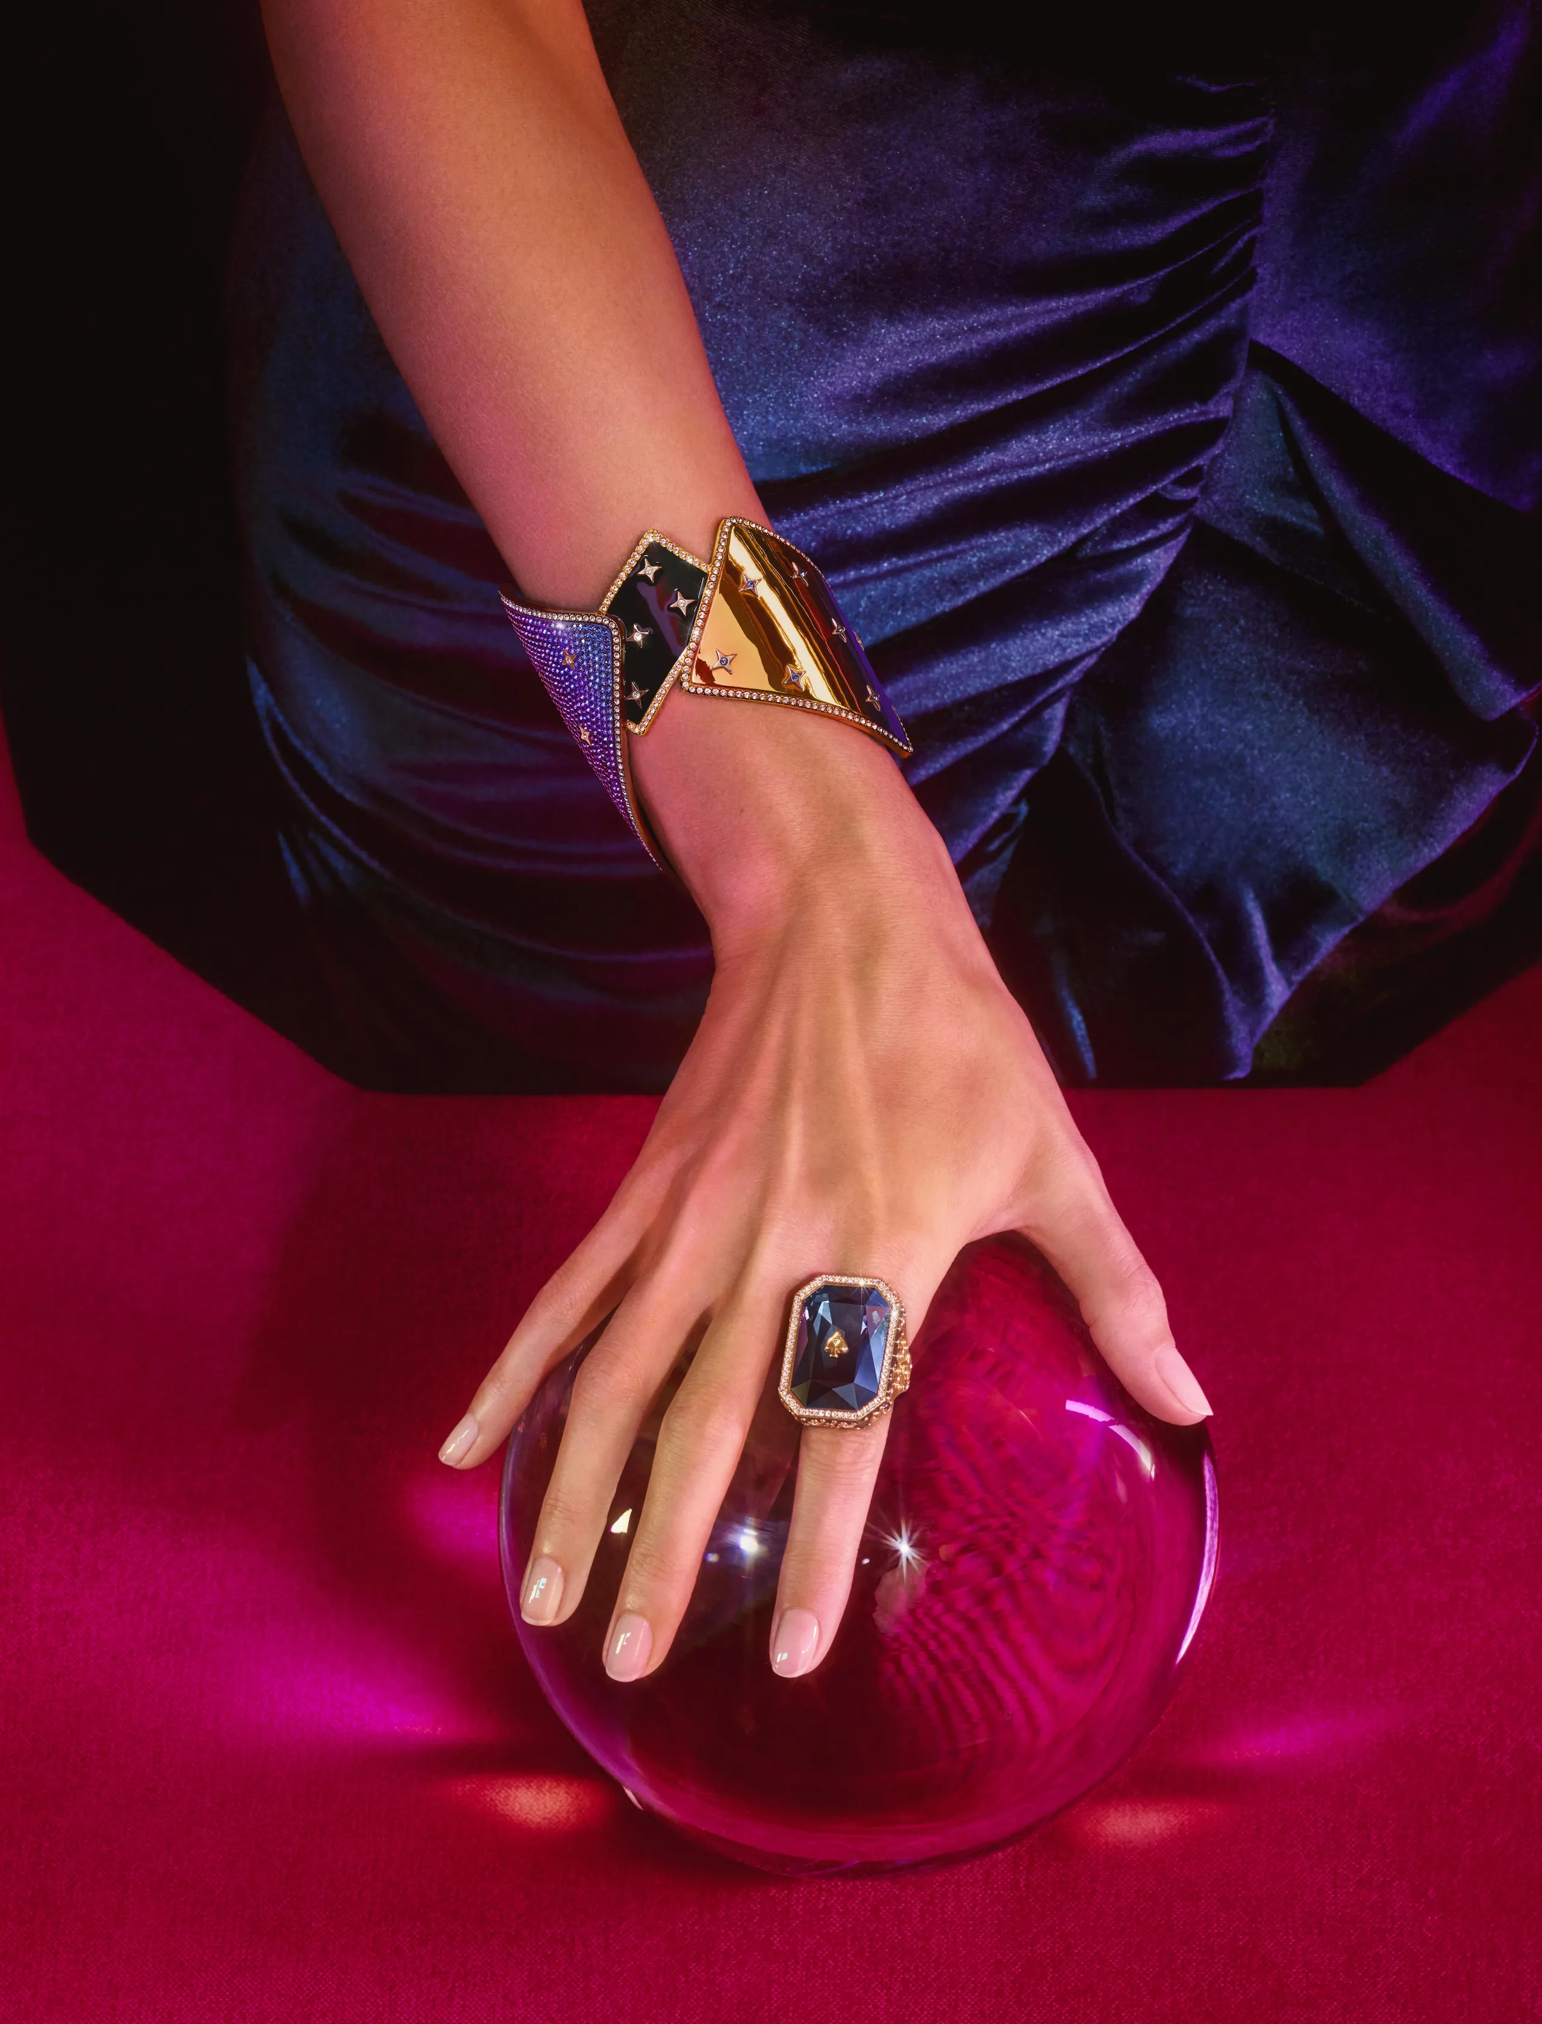
MARKET TRENDS
Swarovski has always had a luxury side, in fact, it competes with luxury brands on some pieces. Swarovski, however, also has a premium product range, with lower and more affordable prices.
The aim of Robert Buchbauer, descendant of the Swarovski family and CEO of the company, is to eliminate the mass market segment and focus only on the luxury segment. This idea is not new, as the Atelier Swarovski line was launched back in 2008 with prices starting at €600. Subsequently, the Fine Jewlery line was also launched, with top-quality pieces that can reach staggering prices of up to €45,000. 'Ignite your dreams' is the new slogan for this new path of elegance and, at the same time, glitz.

Slide 9
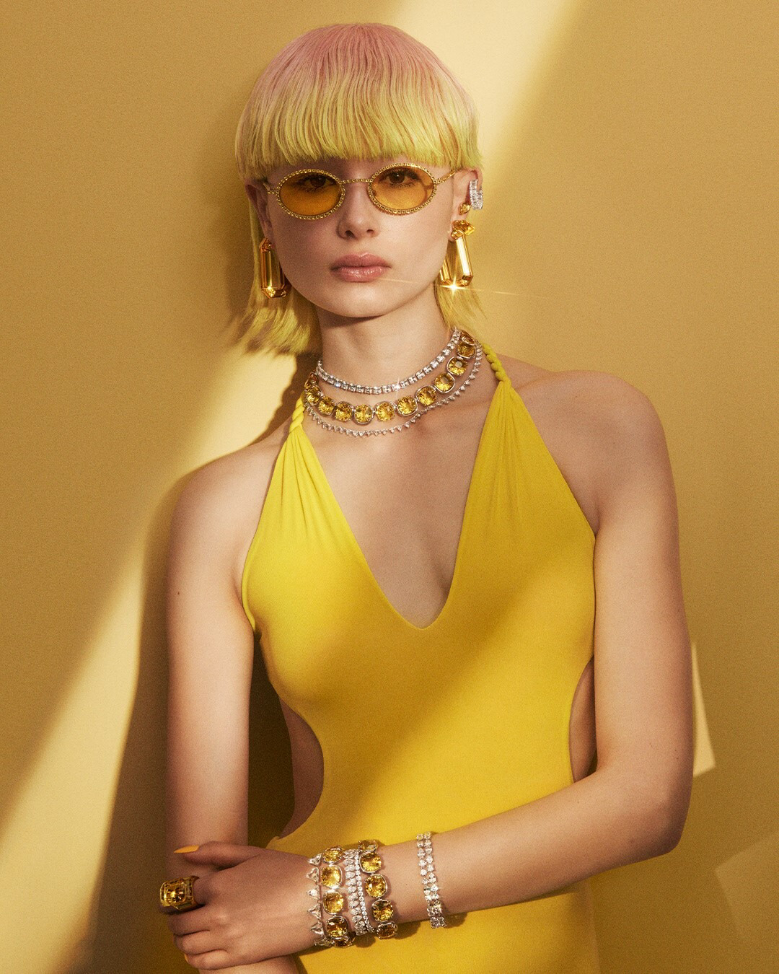
FUTURE MARKET TRENDS
"The strategy for the next three years will be based on four fundamental pillars: to win in the world of crystal through new collaborations and the development of the licence portfolio, to implement the presence in the most important cities for the brand on a strategic level, and to take the Swarovski luxury concept worldwide, while also increasing the productivity of the shops (online and offline) thanks to the new design identity, introduced by Giovanna Engelbert. The customer will always remain at the centre of everything we think, design, implement and sell, through a unique, digital and modern customer experience".

Slide 10
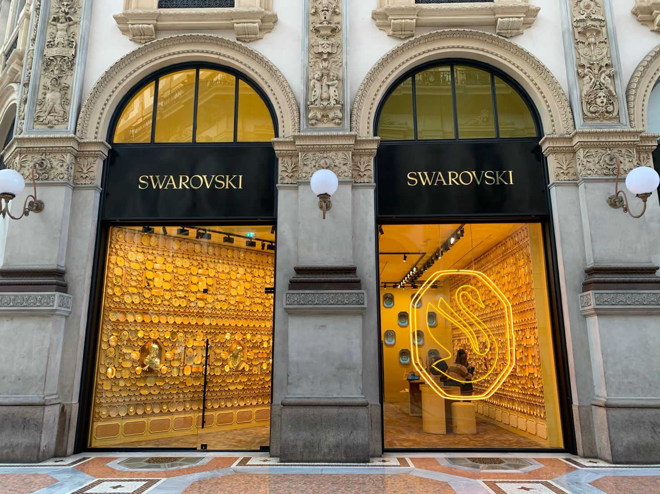
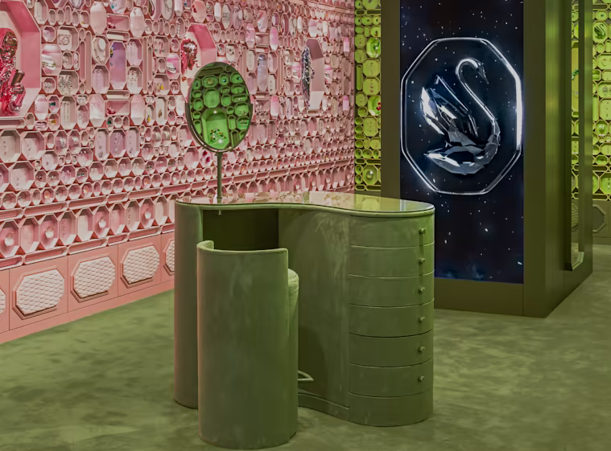
The strategic pillars apply in the US and Chinese markets, the most important for Swarovski, as well as in Italy, where the brand shows more maturity and visibility, thanks to important showcases such as the store in Galleria Corso Vittorio Emanuele in Milan.
FUTURE MARKET TRENDS
"In the future we will focus on emerging markets, such as India, where we are investing heavily with expansion plans to triple turnover in the next three years. In addition, the new LUXignite strategy focuses on 50 large cities around the world where Swarovski is able to reach a large number of customers. The aim is to make the big cities catalysts, and then have an impact in the rest of the territory as well".

Slide 11
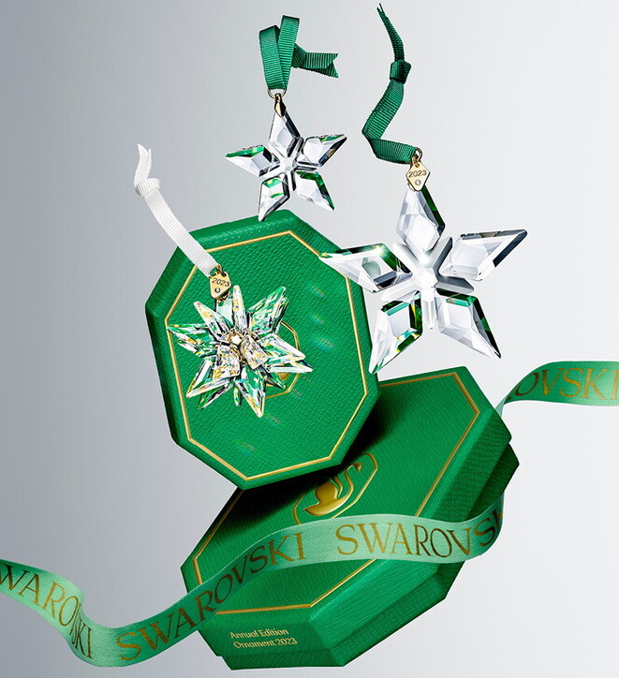
BUSINESS STRATEGY
In order to be competitive in a market where quality products must be accompanied by a unique shopping experience, excellent service and the convenience of buying at any place and time, the commercial strategy must consider a multitude of aspects: "The product, the fulcrum from which everything starts, omnichannelity, the capillarity of distribution and the understanding of the reference customer, of his desires. Only Swarovski is able to produce affordable complications, i.e. families of jewellery which, due to their complexity and production expertise, approach the world of high jewellery, while maintaining an affordable price for the public".

Slide 12
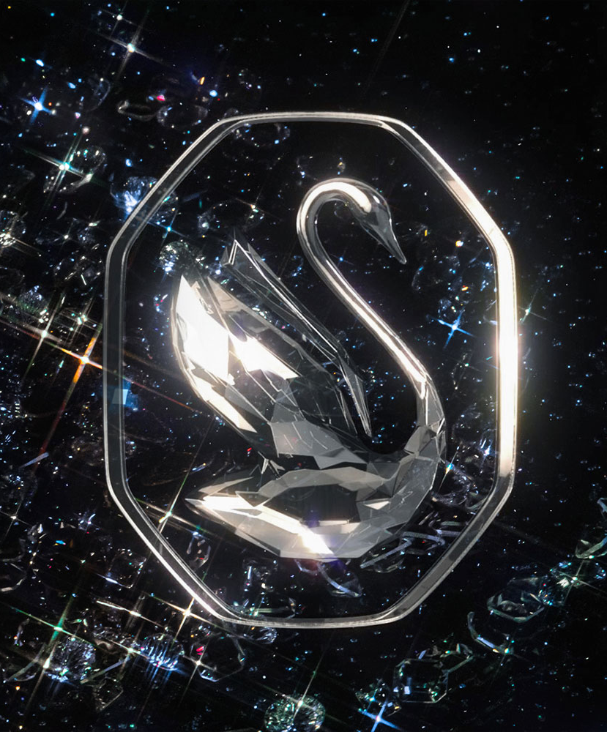
LOGO REDESIGN
In 2021, Swarovski decided to make itself even more innovative by redesigning its corporate logo and creating a new identity, the purpose of which is to invite its consumers to ignite their dreams through the slogan 'Ignite your dreams'. The new design was created by New York-based studio General Idea and ushers in the 125th anniversary of the Swarovski company with the new logo, from the experimental typographic styles, to the colourful yet luxurious packaging, to the immersive and totally new sales experience for the company.

Slide 13

In the logo, the swan points its head upwards, ready to take flight; a metaphor for projection into the future. Through this logo, Swarovski wants to keep the iconic swan, a symbol of pride for the company itself, loyal to its audience, while at the same time strengthening its vision towards the future. The most distinctive feature compared to the classic logo is the frame placed around the swan with the aim of delimiting it within boundaries.
THE NEW LOGO
The symbol is set in an octagon to evoke a carved crystal or diamond, thus allowing the pictogram to be presented on its own.
The new representation faces to the right, instead of to the left as in the past, allowing the neck of the animal to be further accentuated, now longer and more similar to Swarovski's initial letter 'S'.

Slide 14
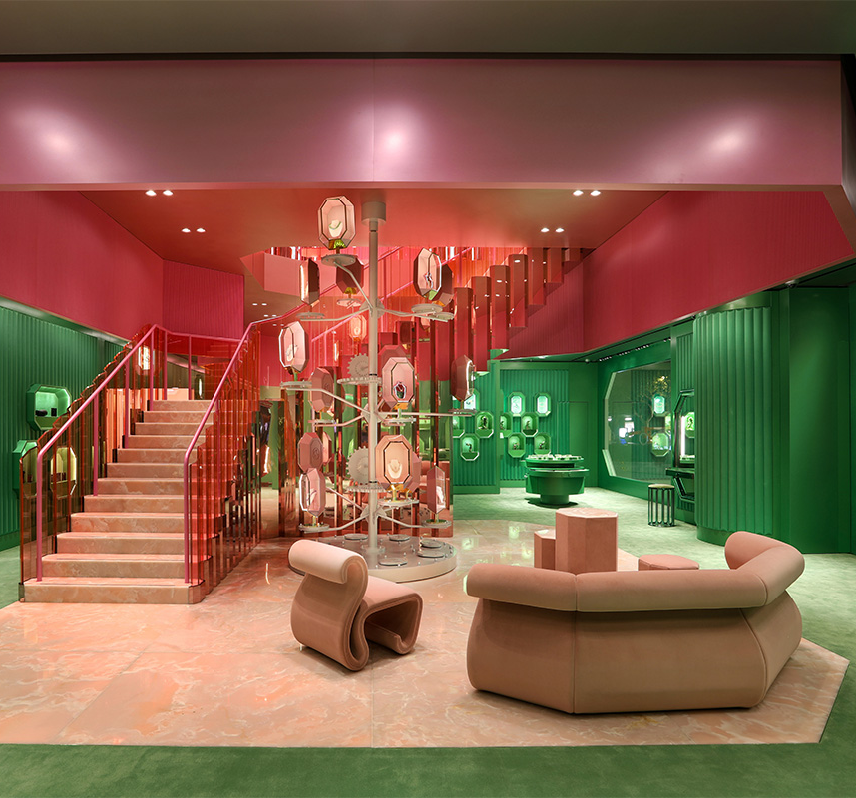
THE NEW WONDERLAB STORES
WonderLabs are real shops and creativity workshops that invite consumers to enter them to make their dreams come true, celebrating their individuality, all in an inclusive context.
The campaign aims to interpret a modern lifestyle where magic and science meet, conveying a sense of wonder to anyone entering a new shop. Another advantage comes from the decision to sell both online and offline through Wonderlab shops, as this is the only way to truly convey the fascinating shopping experience to customers.

Slide 15
STRENGTHS
WEAKNESSES
STRENGTHS AND WEAKNESSES OF THE BRAND
Crystal quality
Elegant design
Wide variety of products
Exclusivity
Technological innovation
Craftsmanship
High price
Imitations and counterfeits, due to brand popularity
Economic sensitivity: in difficult economic times, consumers may reduce spending on luxury products, affecting Swarovski's sales

Slide 16
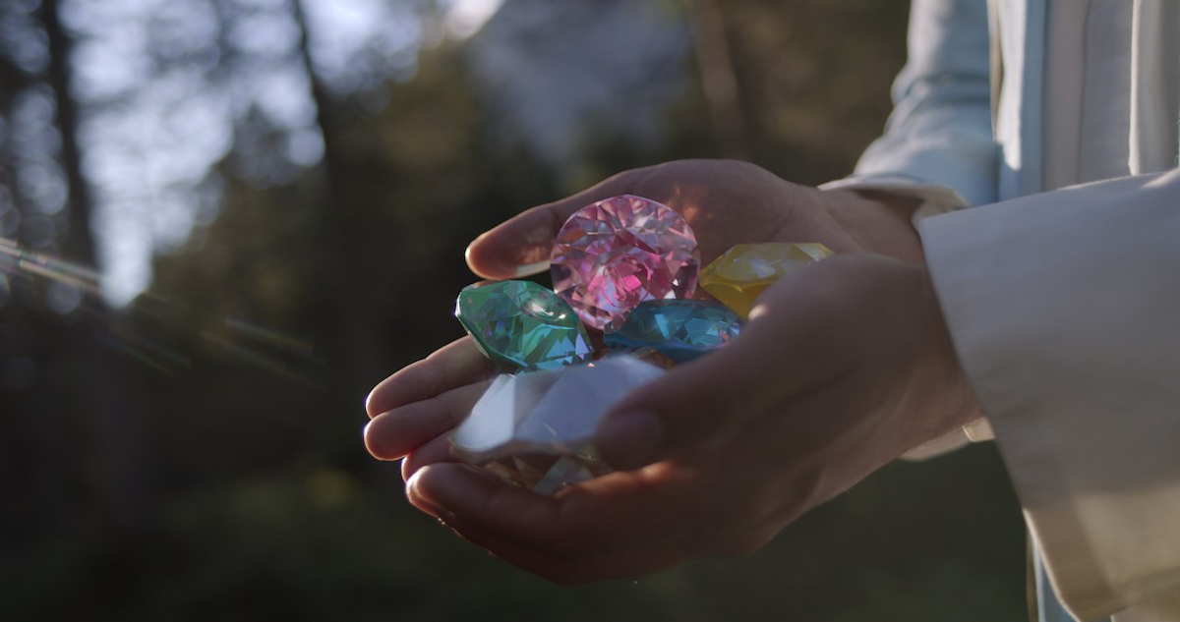
SUSTAINABILITY
Swarovski has been committed to sustainable crystal production for decades, with a new strategy focusing on six areas of environmental and social impact by 2030, such as responsible metal sourcing. The transformation of production processes has already led to significant results, such as a capsule collection with recycled metals and certified packaging. In terms of materials, Swarovski has eliminated the use of lead in its crystal products since 2012, developing a unique technology that maintains brilliance without using lead dioxide.

Slide 17

SWAROVSKI AND PRIDE
We defend personal expression and individuality
At Swarovski, we gladly support our LGBTQ colleagues and Pride, always and every day. We strive to bring out the best in everyone, ensuring that everyone has the freedom to express themselves in a safe and supportive working environment. We believe that the essence of Pride is about standing side by side in love and friendship, teaching tolerance, educating about the history of the LGBTQ+ community and continuing to progress towards equality. Every human being has the right to feel good about themselves.
We are a brand founded on equality and inclusiveness, we promote diversity and always celebrate the individuality of each person.

Slide 18
SITOGRAPHY
https://www.ilsole24ore.com/art/swarovski-addio-prodotti-di-massa-futuro-ora-e-lusso-ADmH9jOB
Market trends (interview Michele Molon): https://forbes.it/2022/12/19/swarovski-futuro-alta-gioielleria/
https://marketingsemplice.community/la-nuova-strategia-di-swarovski/
Swarosvki and pride: https://www.swarovski.com/it-IT/s-swarovski-pride/

